Slide 1
6.19-6.26 Prompt Tuning 文章阅读记录

Slide 2
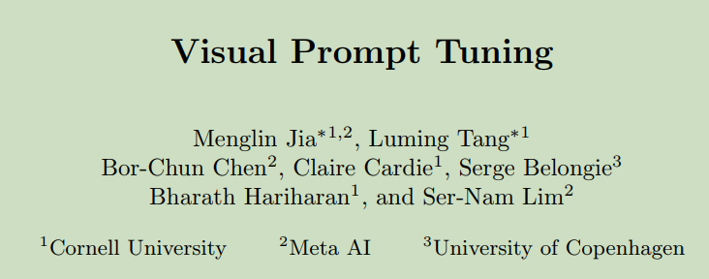
1. Visual Prompt Tuning, ECCV 2022, Cornell University

Slide 3
Arguments & Motivations & Contributions
Motivation: what is the best way to adapt large pre-trained Transformers to downstream tasks in terms of effectiveness and efficiency?
Arguments:
(1) Full fine-tuning: low memory and time efficiency
(2) fine-tune only a subset of the parameters: under-perform full fine-tuning in accuracy
Contributions:
(1) Proposed Visual-Prompt Tuning
(2) Freezing the entire pre-trained Transformer; introduce a small amount of task-specific learnable parameters.
1. Visual Prompt Tuning, ECCV 2022, Cornell University

Slide 4
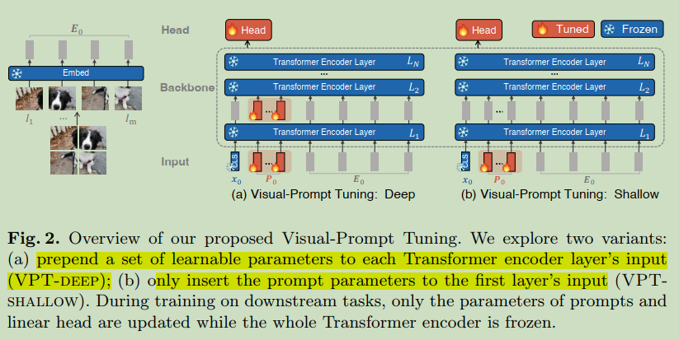
Method
Prompting originally refers to prepending language instruction to the input text so that a pre-trained LM can “understand” the task.
1. Visual Prompt Tuning, ECCV 2022, Cornell University

Slide 5
Method
X0: class embedding, freeze
Prompt: task-specific, learnable
VPT-shallow: 仅在首层输入加入prompt
VPT-deep：在每层都加入prompt，各层prompt向量不同
Class embedding; prompt; feature 直接进行 concatenation
1. Visual Prompt Tuning, ECCV 2022, Cornell University

Slide 6
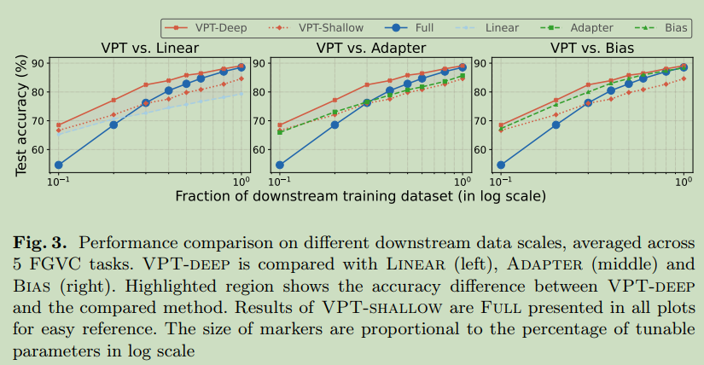
Experiments
On 24 downstream recognition tasks, VPT beats all other transfer learning baselines, even surpassing full fine-tuning in 20 cases.
1. Visual Prompt Tuning, ECCV 2022, Cornell University

Slide 7
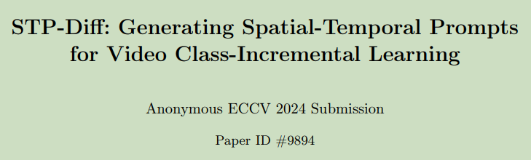
1. Visual Prompt Tuning, ECCV 2022, Cornell University

Slide 8
关于STP-Diff的疑问：
（1）Sec 3.3 损失l_diffusion-classification 的具体怎么实现的，大概推测是每次训练diffusion的到P0的预测值继续用来做分类。
（2）需要在stage1里边先优化得到prompt的真实值，只是这几十个数据是否能够支撑训练一个diffusion，有没有过拟合的问题，以及如果直接用个feed-forward或者GAN来替换diffusion效果会有多大的差距。
（3）如果要加入新的任务，是否需要对diffusion再进行微调，如果需要的话，那么微调diffusion会不会也带来forget的情况。如果不需要的话，这种少量数据下训练的diffusion的泛化能力能否支撑需求。

Slide 9
123防守打法
123中国人
3. Free-Bloom: Zero-Shot Text-to-Video Generator with LLM Director and LDM Animator, Shanghai Tech University, NIPS 2023

